Slide 1
UIT2201 – Programming and Data Structures
Shallow and Deep copying

Slide 2
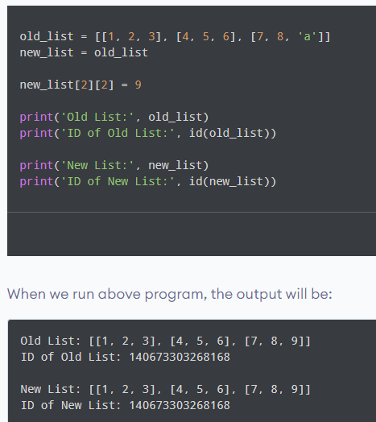
Copy an Object in Python
In Python, we use = operator to create a copy of an object. You may think that this creates a new object; it doesn't.
It only creates a new variable that shares the reference of the original object.

Slide 3
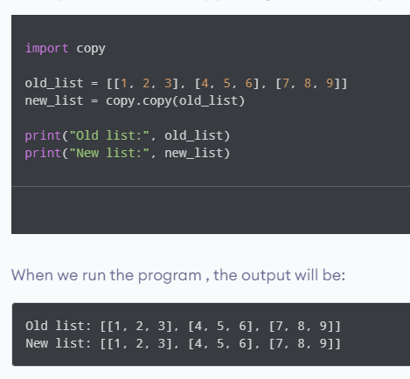
Shallow Copy
A shallow copy creates a new object which stores the reference of the original elements.
So, a shallow copy doesn't create a copy of nested objects, instead it just copies the reference of nested objects. This means, a copy process does not recurse or create copies of nested objects itself.

Slide 4
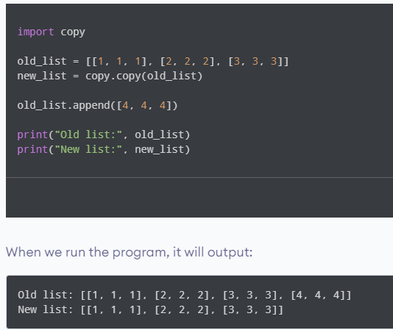
Adding [4, 4, 4] to old_list, using shallow copy

Slide 5
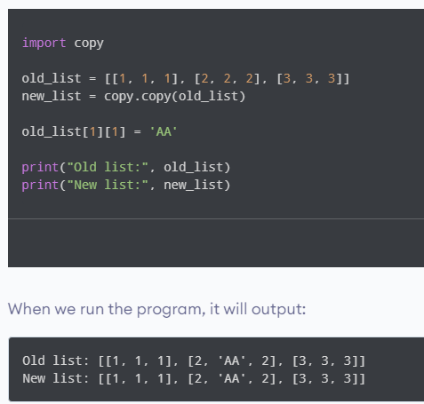
Adding new nested object using Shallow copy

Slide 6
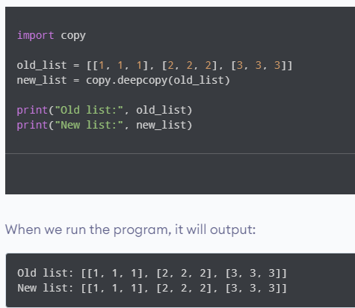
Deep Copy
A deep copy creates a new object and recursively adds the copies of nested objects present in the original elements.

Slide 7
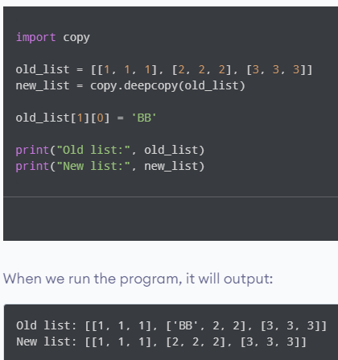
Adding a new nested object in the list using Deep copy

Slide 8
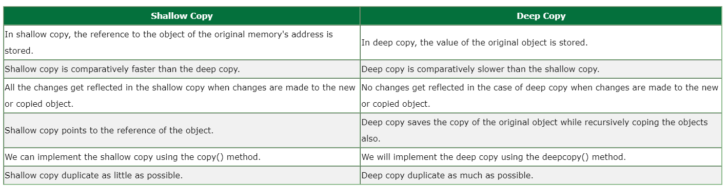
Difference between Shallow and Deep copy

